Slide 1
Study Design
[Session 2]
Group 3: Casey Filler, Soroush Dianaty
Lullaby: A Low-Burden Digital Health Intervention for Postpartum Hypertension Monitoring in Heat-Stressed Safety-Net Communities

Slide 2
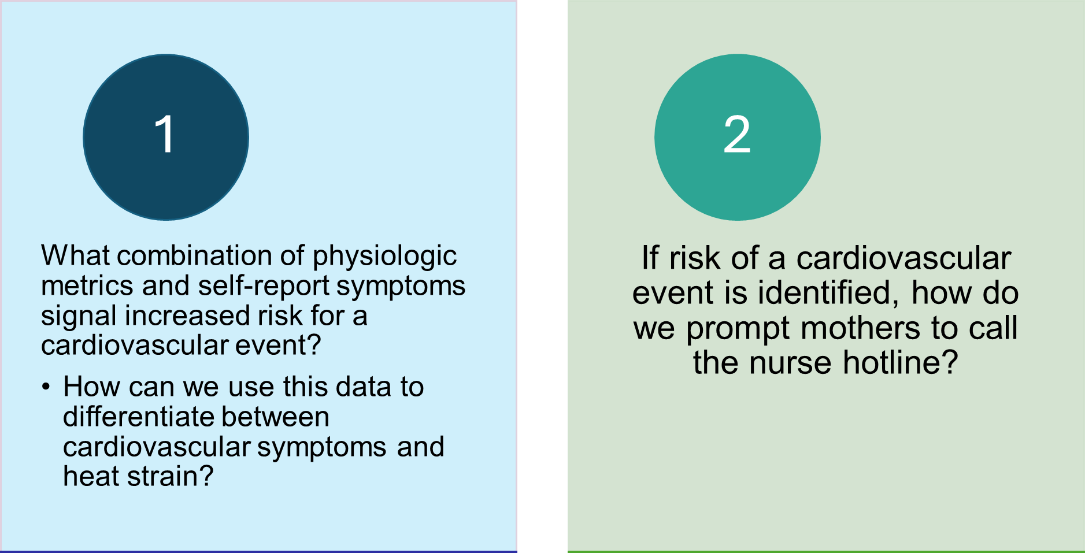


Research/Scientific Question. Identify at least one research question that you need to answer in order to either construct or test your intervention. Think about what you don’t know yet about your intervention that would lend itself to a research study.

Slide 3
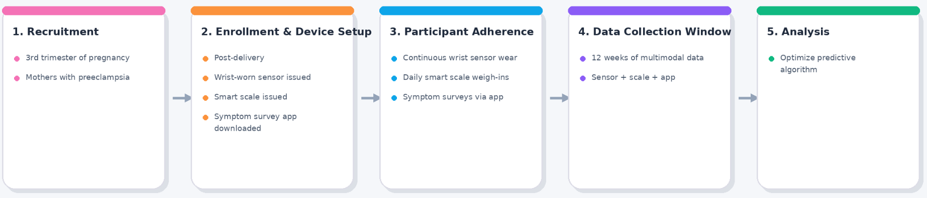
Study Design: Prospective cohort study with repeated measures
Preparation phase of MOST: observational data needed to lay the groundwork for optimization
Primary distal/clinical outcomes: confirmed CV event, confirmed heat-related illness, hospitalization/ED visit
Proximal outcomes: False positive/false negative alert rates, completion rates of self-report surveys when prompted, success rate of appropriate user response (call vs. no call)
Conceptual model uses a combination of physiologic and self-report data to accurately predict CV events and differentiate between this and heat strain
Identify set of components for optimization prior to randomized trial
No control condition
Record as much data as possible to create a database to inform decision making

Slide 4
Intervention components. What theoretically and/or empirically-grounded intervention components will you include in your intervention? Justify the selection of these specific components.
Physiologic risk threshold - most important
Independently elevated BP vs. elevated BP + tachycardia + increase in body temp.
Heat strain differentiation
Ambient temperature, total body water, duration of fluctuations
Timing of analysis through wrist-worn sensor (frequency of measurement → analysis → decision making)
10 minutes? Hourly? Daily? (EDA of data collection frequency)
Symptom survey design
Which symptoms to include
Does survey adapt based on answers?
Alert strategy
Wording of prompts to encourage appropriate user response
Urgency
Engagement with scale and wrist-worn sensor
Reminder prompts? Text messages?
Nurse triage workflow
Suggestion to call RN hotline vs RN calls patient
Notes:
Which combination(s) of data actually predict(s) a CV event?
Sensitivity of physiologic risk threshold important - if too sensitive, then too many false positives > annoying > mothers don’t trust. If not sensitive enough, fail to predict CV events

Slide 5

Technology Development & Team Synergy
Bridging behavioral science and data science to build robust, patient-centered health tools.
Core Technologies
Data Collection Hardware
A wrist-worn device with 3 biosensor (PPG, temp, gyro) for measuring vitals and body temperature
Smart scale with bioimpedance and weight sensors to measure weight and body water and hydration).
Patient-Facing App
Mobile interface with active (scheduled and event-triggered surveys) and passive (sensor and user experience) data collection used to fine-tune an existing publicly available model.
Backend / Cloud Server
HIPAA-compliant server (GCP)
Team Synergy
analytics Data Science Perspective
Curation, AI algorithm development, and accuracy optimization (>80%).
psychology Behavioral Science Perspective
UX design for postpartum mothers; optimizing tone/timing to reduce burden.
The Collaboration
DS identifies medical necessity; BS dictates how alerts are communicated and acted upon.

Slide 6
Sample Size, Recruitment & Retention
Strategic approach to participant enrollment and engagement for predictive modeling.
Sample Size
Determination
Depends on number of parameters needed for model fine-tuning.
Target: N=150-200
Aims for 10-15 CV events per predictor variable to ensure high accuracy.
Recruitment
Partnerships
Leveraging social groups and health clinics in South Phoenix/Mesa.
Timing & Framing
Recruit high-risk mothers in 3rd trimester or post-delivery
Retention
Combating Attrition
Incentives: Phased rewards (diapers, gift cards) for wear-time.
Frictionless: Heavy reliance on passive monitoring.
Engagement: AI and human agents having real-time interaction with participants to ensure compliance and providing educational material.

Slide 7
Budget Needs & Justification
Comprehensive funding requirements for high-fidelity data collection and algorithmic training.
Participant Costs
(Based on N=150)
Hardware: ~$70/pp ($50 wearable + $20 scale)
Incentives: ~$150/pp (12-week protocol completion)
Subtotal: $33,000
Technology & Staff
(Fixed Project Costs)
ML Engineer: ~$20,000 App development, MLOpS
Coordinator: ~$10,000 Recruitment & retention
RN Hotline: ~$5,000 Emergency triage retainer
Total Funding
~$68,000
Justification
By the end of this pilot study, we will achieve:
App MVP
Multimodal sensor data to fine-tune a validated, publicly available model for our specific population.
Feasibility and compliance data
User experience data for better app design

